Slide 1
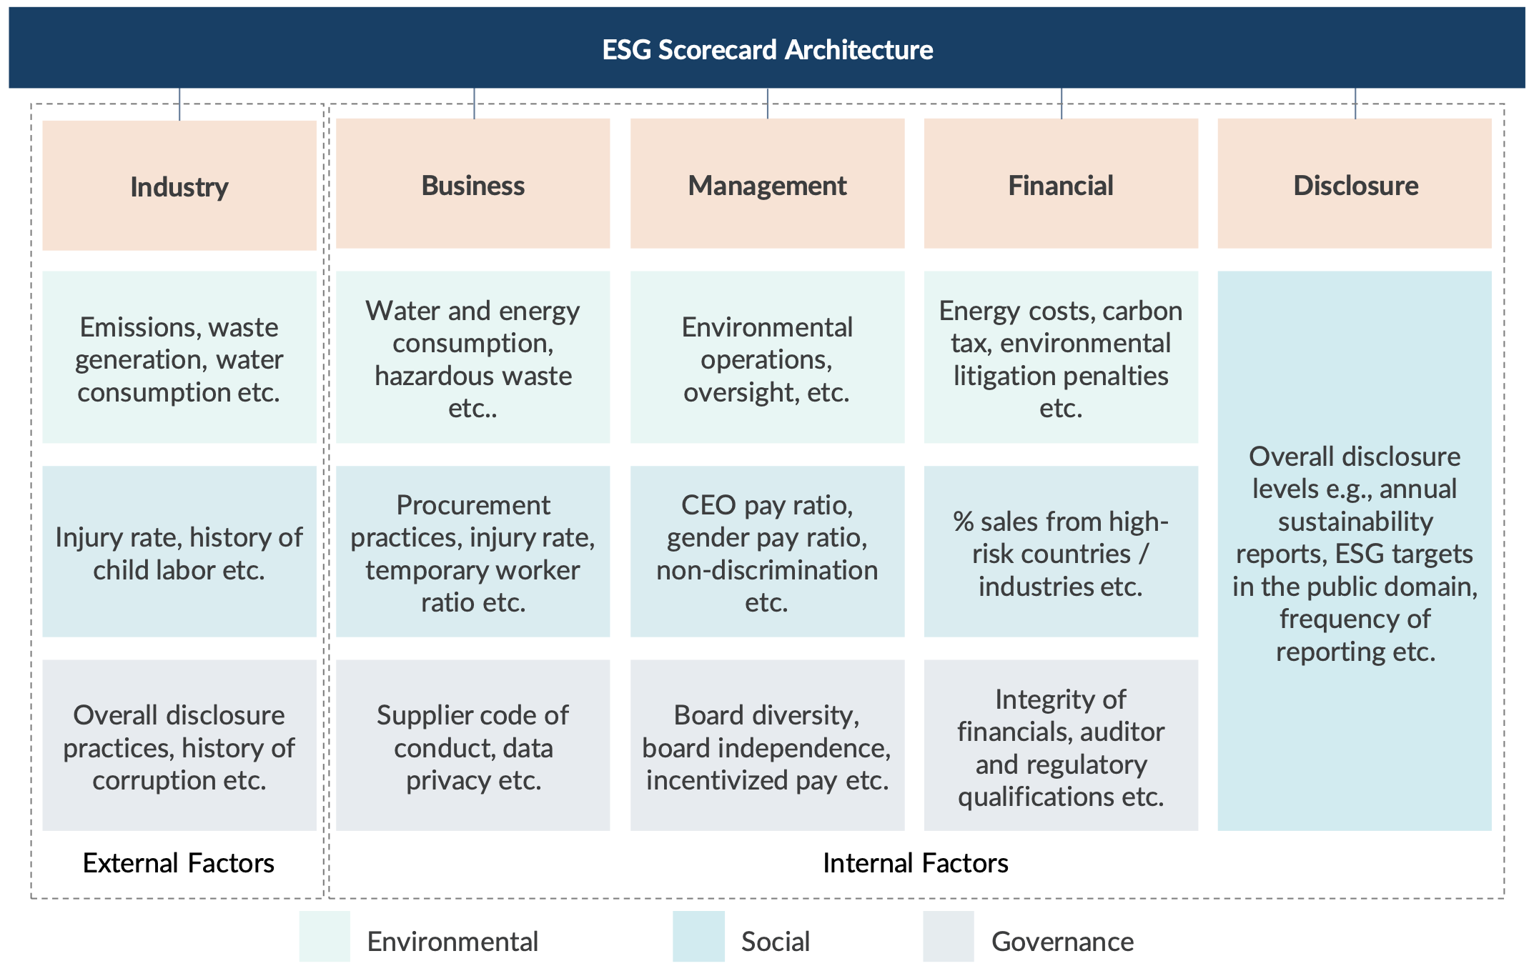
Integrating ESG Risks Into Credit Assessment: Sustainability Use Case
Understanding ESG
Define ESG metrics across each dimension
Mechanism for scoring and integration with credit decision-making
ESG and Credit Risk Integration Matrix
Environmental Risk
Social Risk
Governance Risk
1. Identify the categories or dimensions which they intend to understand and evaluate their borrowers’ ESG performance
2. Form an ESG library through identification and definition of metrics, and assignment of criticality and limits to them
3. Map the ESG metrics to each of the dimensions and prioritize parameters that are required or emphasized by regional regulations
After defining a base architecture of the ESG assessment framework, the next step is to combine the evaluation of individual metrics to arrive at a consolidated ESG profile of the borrower, and further integrating the same with the credit assessment to arrive at a holistic profile of the borrower
> Damage to PPE and inventory due to environmental catastrophes, like floods and fires etc.
> Supply chain disruptions due to environmental catastrophes and inadequate rainfall
> Govt. policies for transition to net zero emissions
> Labor strikes due to violation of labor rights
> Increase in workplace injuries
> Association with the blacklisted vendors for human rights violation
> Skewed workplace gender ratio
> Increase in regulatory penalties
> Increase in compliance breaches
> Resignation of independent directors due to non-compliance to ESG policies
> Adverse auditor qualifications due to non-compliance with internal policies
Proposed Approach: Develop a separate scorecard for ESG assessment and merge the output with the existing credit scorecard architecture.
- Two outcomes which may be merged to arrive at an adjusted rating. An illustrative merging approach is highlighted in the figure below, where the values in the cells indicate how many levels the credit-based rating output must be notched down based on the ESG output
Rating adjustment (notch-down) matrix
Rating adjustment Matrix |  | Output of ESG scorecard*
 |  | ESG1 | ESG2 | ESG3 | ESG4 | ESG5
Output of credit risk scorecard | CR1 | 0 | 1 | 2 | 3 | 4
 | CR2 | 0 | 1 | 2 | 3 | 4
 | CR3 | 0 | 1 | 2 | 3 | 3
 | … | … | … | … | … | …
 | CR10 | 0 | 0 | 0 | 0 | 0
Adverse revenue impact
Increased operational and compliance cost
Risk of interruption/stoppage of operations
Reputational risk affecting investor and consumer sentiments
Adverse Impact on Credit Profile
4. Define units and assign specific limits and tolerances to the individual metrics, expressed either as qualitative or quantitative measures
Increased Probability of Default
* On an illustrative 5-point scale, with a higher numerical suffix indicating higher risk level
Standard Chartered: Strategy and Market Activities
Internal ESG rating that is assigned to a company, which is an evaluation of its focus and direction when it comes to ESG issues. Their rating factors in how well the company manages ESG issues that are most material to its business.
How they determine a company’s ESG rating: Companies span many different sectors, so most third-party ESG ratings are assigned against a set of industry-specific criteria, relative to its peers. These include material ESG factors that can impact stakeholder value for the company. They update them regularly, which allows their analysts to monitor progress or deterioration against set goals and update their assessment.
What they do with the ratings: They produce unique insights into how corporates are performing on ESG-related issues. If these insights are built into their analyst ratings system, it can help investment managers by providing a forward-looking view of factors influencing a company’s ESG performance and direction, not being involved in ESG controversies and allowing them to consider the non-financial risks and opportunities associated with sustainable investing
Note:
The influence of ESG ratings on a company's credit risk score is non-linear and context-dependent. For companies already in poor credit standing, the primary drivers of creditworthiness are typically unrelated to ESG factors, which reduces the relative impact of ESG considerations.
Alternative: Integrated Credit-ESG Rating Scorecard
In this case there will be a single score/output linked to corresponding probability of default
For example, the assessment of business risk may include ESG-specific risks, e.g., Litigations around environmental or social controversies

Slide 2
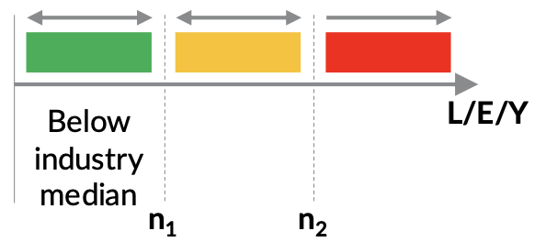
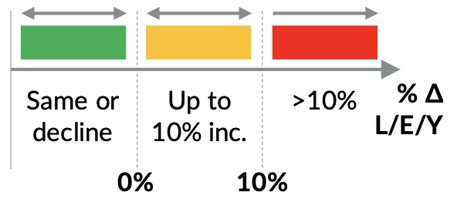
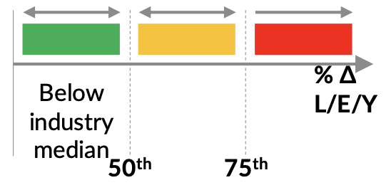
Example of defining units, limits, and tolerances for a sample ESG metric
 | Option 1: Absolute Benchmarking | Option 2: Trend Analysis | Option 3: Industry Benchmarking
Description | Standalone – Absolute | Standalone – Trend | Relative to Industry
Definition | Water consumption per employee per year. | YoY change in water consumption per employee per year (avg. for last 3 years) | Water consumption per employee per year w.r.t industry median
Unit | Litres/Employee/Year | % Change in Litres/Employee/Year | % Change in Litres/Employee/Year w.r.t Industry Median
Limits and Tolerance
Pros | + Easy to measure. | + Easy to measure. + Indicates effectiveness of borrower’s measures to reduce impact. | + Factors in industry usage and benchmarks.
Cons | - Does not factor in trends or industry benchmarks. | - Does not factor in trends or industry benchmarks. - Absolute consumption may still be high. - Borrower’s may not have historical data. | - Requires industry related detailed data.
Potential Road map
 | Short Term | Medium Term | Long Term
Large Corporate Groups | Option 2 | Option 3
Medium Corporates | Option 1 | Option 2 | Option 3
Small & Medium Enterprises |  | Option 2 | Option 3

